Slide 1


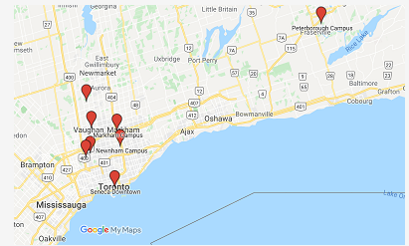
WHY SHOULD CHOOSE SENECA COLLEGE
DEPIKA TRIBHAWAN
Jing wang

Slide 2



Con
10 CAMPUSES
146 FULL –TIME PROGRAMS

Slide 3


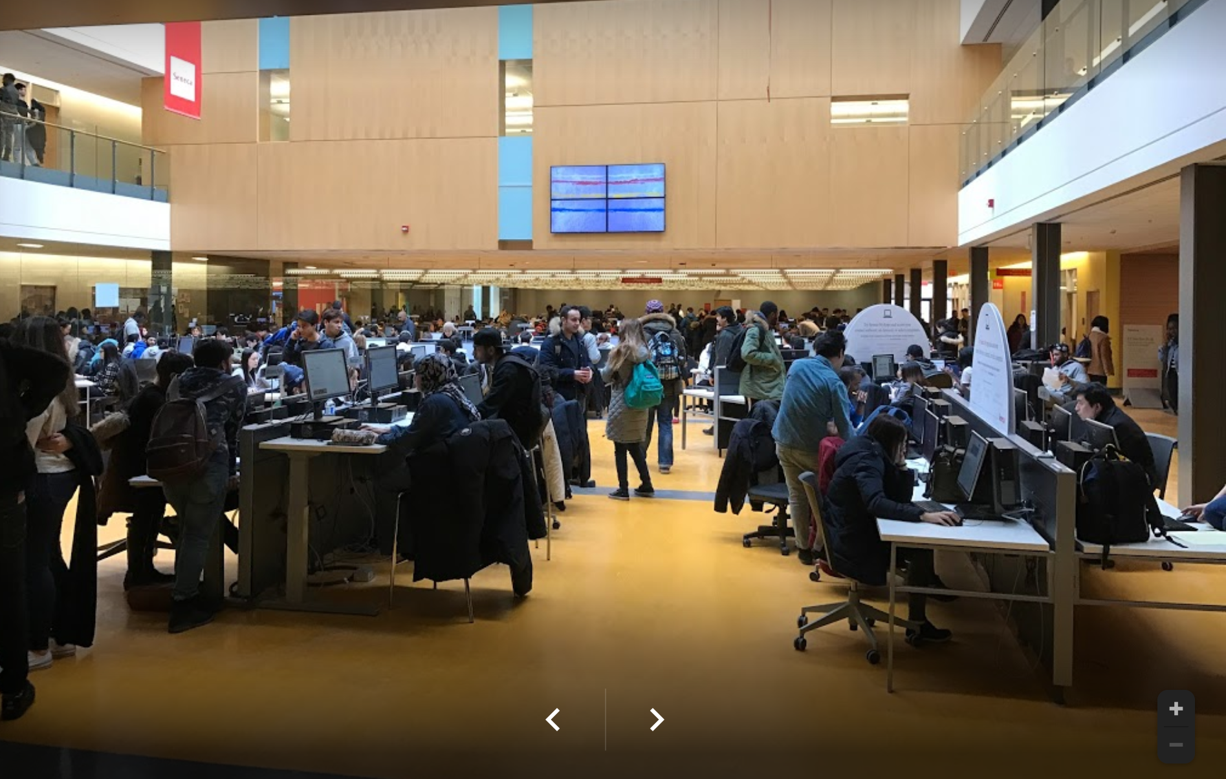
EXCELLENT PROGRAM
HELPFUL TUTORS

Slide 4
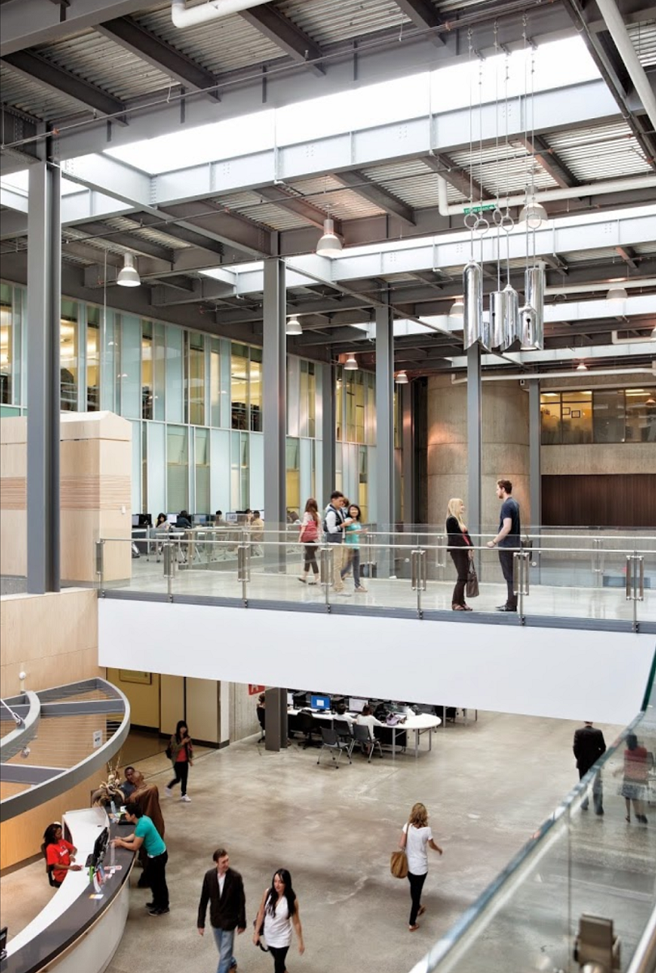
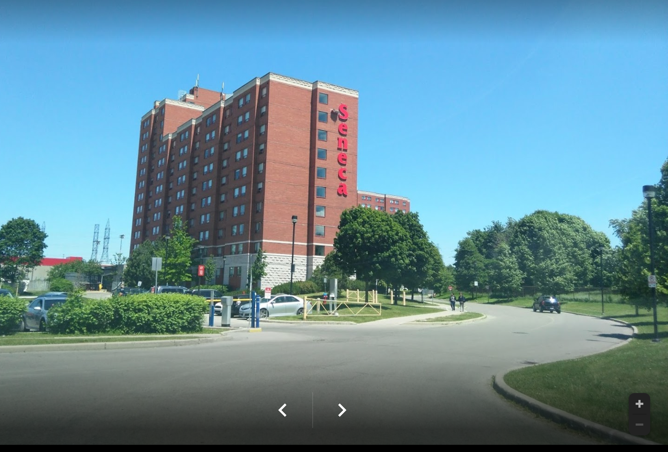
Con
UNIQUE
EXELLENT
EFFECTIVE

Slide 5



Thank you !
WHY NOT SENECA

